Slide 1


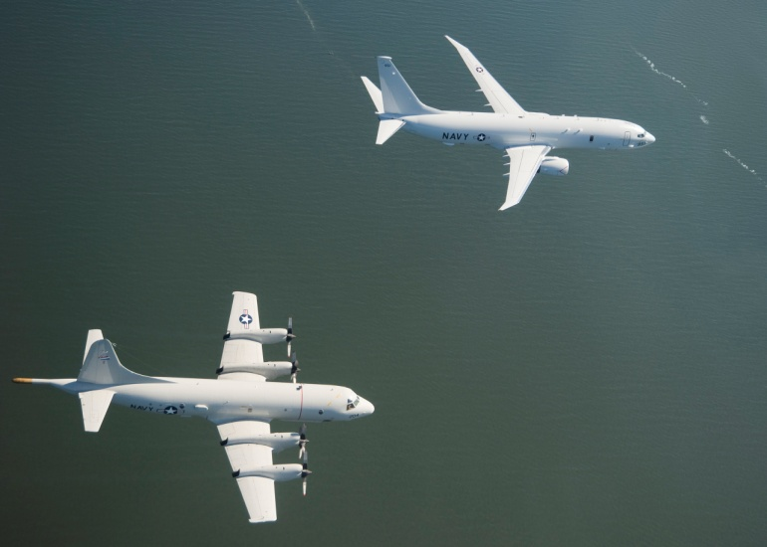

Aviation Manpower Requirements
Code 30
Notes:
1

Slide 2
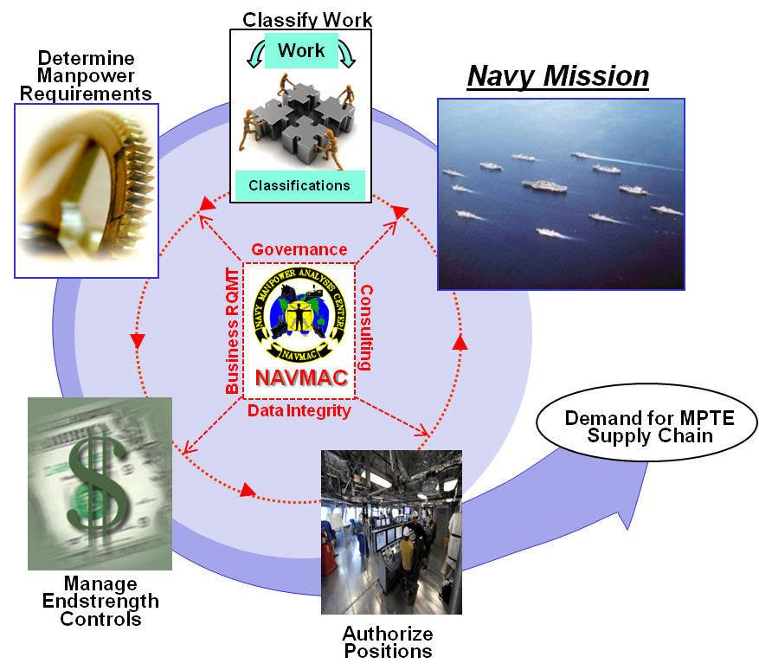

Navy Manpower Analysis Center
Defining the Manpower Demand
…we define, translate, and classify the Navy’s work into a workforce structure and position demand signal to sustain a combat ready force…
Vision
…we lead the Navy in manpower solutions…
  Adding value by defining Navy’s work and creating accurate manpower demand signals for FIT
2

Slide 3
Navy Manpower Analysis Center
At a Glance
  Navy’s Occupational Classification Systems
  Fleet Manpower Requirements Determination
  Navy’s Manpower Management Program Administration
  Navy’s Manpower Information System Business RQMT
Mission
Areas
Primary Outcomes
Navy Military Manpower RQMTs
  Effective Job & Qualifications Management
    Military human resources structures (e.g., Rating, NEC, NEBC, Designator, AQD, NOBC, SUBSPEC)
  Valid Ship/Squadron Manpower Requirements
    209K RQMTs - 43% of Navy’s Military RQMTs
  Effective Manpower Management Processes & Policies
    Authoritative Activity Manpower Documents (AMDs) for 6,140+ Units & 7471 Positions
  Effective Information System Performance of Manpower Processes
    Activity Manpower Management (TFMMS) and FMRD support information system performance (40+ Outgoing Interfaces)
$16B
(fully funded)
Civil Service &
Contract
267,666
As of end Jan 2019
3

Slide 4
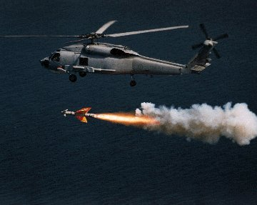
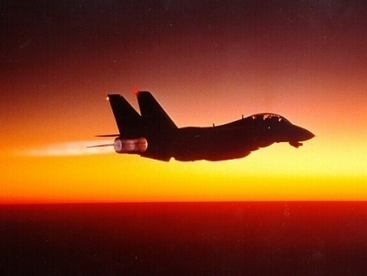
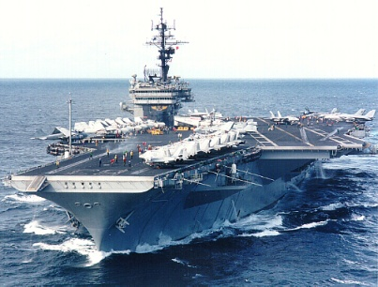
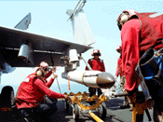
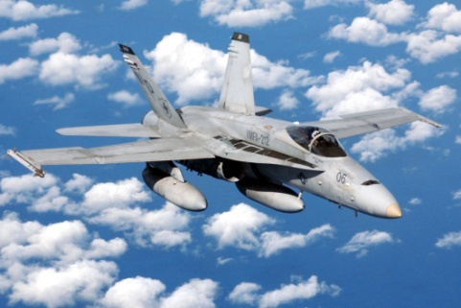
Department's Primary Mission
It’s All About Fleet Readiness…
MISSION: Analyze & determine in accordance with the OPNAVINST 1000.16, the minimum QUANTITY and QUALITY of manpower required to accomplish 100% of capabilities as defined in the latest approved ROC/POE.

Slide 5
Guiding Policies
US Code – DOD - OPNAV
Legal sources do not dictate a manpower program or process
  USC Title 10
  Subtitle A, Part I, Chapter 2, Section 115a states, “The Secretary of Defense shall submit to Congress an annual manpower requirements report”
  Subtitle C, Part I, Chapter 507, Section 5062 states, "The Navy shall be organized, trained, and equipped primarily for prompt and sustained combat incident to operations at sea. It is the responsible for the preparation of Naval forces necessary for the effective prosecution of war."
  Subtitle A, Part II, Chapter 39, Section 691 states, "The end-strength specified ... are the minimum strength necessary to enable the armed forces to fulfill a national defense strategy ... Successfully conduct two nearly simultaneous major regional contingencies.“
  Chapter 117, in part states, "SECDEF establish readiness reporting system to include measure of capability to conduct wartime missions."
DODD 1100.4
OPNAVINST 1000.16L
OPNAVINST C3501.2
  DOD Manpower Management Guidance
  “…Manpower RQMTs are driven by workload and shall be established at the minimum levels necessary to accomplish mission & performance objectives…”
Policy governing
  Manpower Requirements
  Manpower Authorizations
Paragraph 1.a. states…
  “…develop, review, approve, & implement total force manpower RQMTs /AUTHs for Naval activities…"
Master ROC/POE instruction
  Guides development of mission requirements for ship classes & staffs
NAVMAC uses ROC/POEs:
“…to determine class specific manpower requirements to support defined mission functions…”

Slide 6
Aviation Products and Customers
Products
  Squadron Manpower Documents (SQMDs: O-Level)
  Manpower Requirements Worksheet (MRW: I-Level)
  Aviation Fleet Manpower Documents (AFMDs: CAG Staff, MOCs)
  Preliminary SQMD
    Created by NAVAIR
    Checked by NAVMAC for policy compliance
Customers
  Force Commanders
  All Fleet Squadrons
  All FRS’s, VX-1 & VX-9
  Afloat AIMD’s, SEAOPDET, VANOPDET

Slide 7




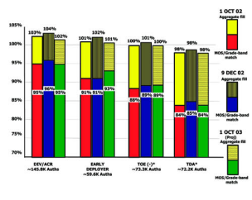

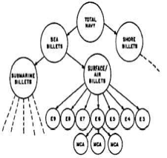
Operational Reality
Manpower -vs- Manning
…manpower requirements are only a part of the overall picture…
Requirements
Endstrength
Authorization
Personnel
RQMT
Work
Funding
Readiness Gap
“Risk”
MFT
Authorization
Classify Work
MNA
COB
Work
ROC/POE
or
TASKING LETTER
Initial Manpower
Specification
My Navy Assignments
Current
On-board
Places
Controls
Demand
Faces
NAVMAC Direct Work
7

Slide 8

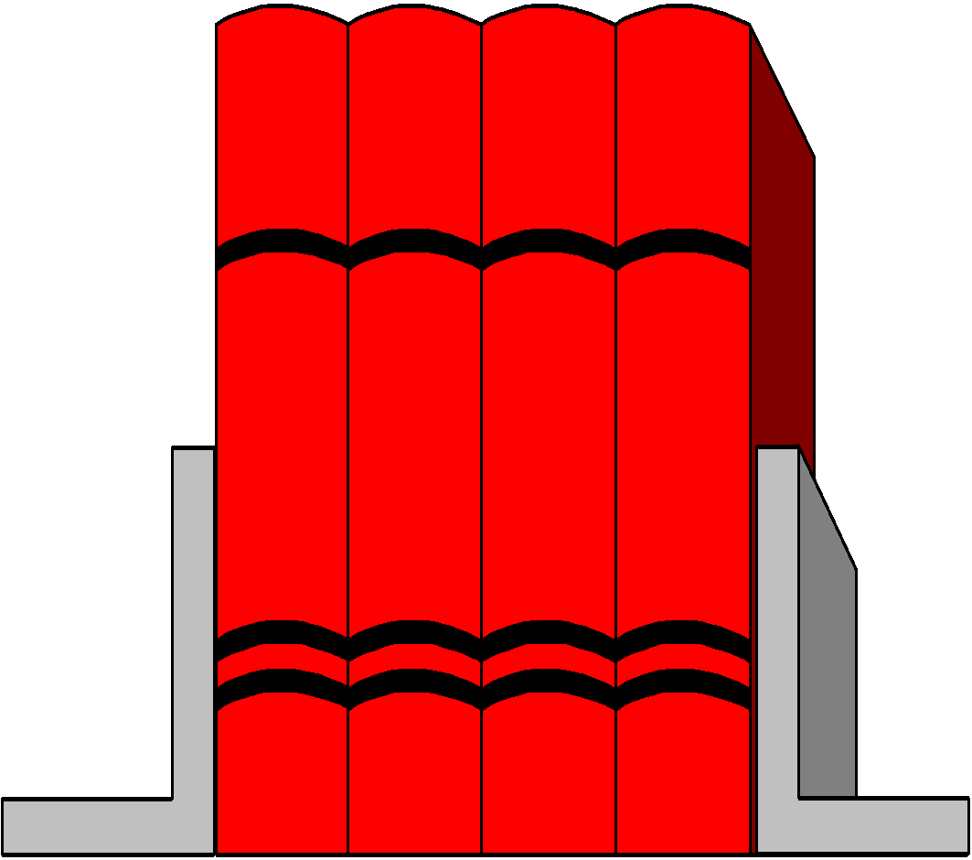


SQMD Methodology
SQUADRON MANPOWER
REQUIREMENTS
COMPUTER SYSTEM (SQMRS)
ROC/POE
STAFFING
STANDARDS
STATISTICAL
MODELS - BASED
ON HISTORICAL
CM (NALDA) AND
CURRENT PM (MRC) DATA
ON-SITE
VALIDATION
IF REQUIRED
DRAFT SQMD
FLEET REVIEW/COMMENTS
ADJUDICATION
BSO BILLET BUY
SQUADRON
LOAD INTO TFMMS

Slide 9
MRW Methodology
TASKING
LETTER
STAFFING
STDS
AIRCRAFT MAINTENANCE DATABASE
ON-SITE
VALIDATION
MAINTENANCE VALUES
DRAFT MRW
LOAD DRAFT INTO TFMMS
FLEET REVIEW/COMMENT (Reclama)
FLEET FORCES/TYCOM
ADJUDICATION
LOAD INTO TFMMS
SHIP/SEAOPDET AMD

Slide 10
Major Data Sources
NAVAIR Logistics Data Analysis (NALDA):
  Documented Corrective Maintenance by:
    Type/Model/Series Aircraft
    Type Equipment
    Production Work Center
NAVAIRSYSCOM:
  Preventive Maintenance and scheduled inspection requirements.

Slide 11
Other Data Sources
ROC/POE (Required Operational Capabilities/ Projected Operational Environment)
TYCOM Tasking Letter
CNO/N1/N98 Directed Functions
Staffing Standards
On-Site Workload Measurement (non-NALCOMIS)
Naval Aviation Maintenance Program (NAMP) COMNAVAIRFORINST 4790.2 Series
Production Planning Factors (PPFs) for FRS

Slide 12
AIMD Maintenance Values
Reported maintenance data from NALDA by T/M/S and equipment supported for:
- Aircraft Maintenance (AM)
- Support Maintenance (SM)
Maintenance data for all deployed carriers is reviewed and updated annually as required

Slide 13
Required Operational Capability/ Projected Operating Environment
ROC: Defines the Mission, Functions and Tasks your aircraft platform is to perform.
POE: Defines the minimum capabilities or parameter to accomplish your aircraft platform’s operations.
  Aircraft Utilization (flight hours / month)
  Sortie Length
  Crew / Seat Ratio
  Primary Aircraft Authorized (PAA)
  Additional Manpower Requirements

Slide 14
TYCOM Tasking Letter
Tasking Letter:
  The most critical element in developing the MRW
    Identifies:
      Aircraft Type/Model/Series (T/M/S) and number
      SEAOPDET identification/location
      Quantity and type of test bench/equipment
      Support Equipment (SE) type and number

Slide 15
SQMD Development
During SQMD development, we use:
  The NAMP to define overall SQMD layout. States a need for work centers that aren’t directly tied to the maintenance of aircraft but, play a vital role in the effort. Examples: QA, Maintenance Control, Maintenance Admin and Material Control.
  Directed Requirements - “Must Haves”
  Staffing Standards to determine support/ non-production work center requirements.
  Measured Workload Equations to determine production work center requirements.

Slide 16
Overview of Major Process
Staffing Standards
Administration
Utility Tasking (Afloat Working Parties)
Facilities Maintenance
Collect Data/
Build Standard
Standards & Directed
Requirements
Apply Standards/Models
and Sum Workload
by workcenter
Draft Squadron
Manpower
Document
Final
Manpower
Document
Reclama/
Adjudication
Update
AMD
Maintenance Models/
Crew Set Ratio
Onsite
Validation
(If Required)
Statistical Models
95%+ of Squadron requirements are determined by mathematically based models

Slide 17
Staffing Standards
Staffing Standards are either Directed or Engineered
  Directed: A requirement specified by instruction/policy (CMC, DAPA, etc.) not otherwise tied to any countable item/event factor.
  Engineered: A relationship between man-hours and a specified set of tasks, written as an equation with at least one countable item/event factor and includes an optimized distribution of both quantity and quality manpower (YN, PS, etc.).

Slide 18
Engineered Staffing Standard
Number of Personnel Assigned Example
Yeoman Calculation
_(.7290) (X)_
Productive Availability Factor (PAF)
X = Total Officer/Enlisted Requirements
X = 236
172.044 divided by 67 (PAF) = 2.56 = 3 requirements
Notes:
.

Slide 19
Staffing Standards
* CMDCM
* CCC
* DAPA
* SAFETY PO
* MC MCPO/CPO/FDC
MC CLERKS
MAINT ADMIN
* DATA ANALYSTS
* DIV CPO
* HAZMAT
TOOL ROOM / IMRL PO
* PHASE SUPERVISOR
TROUBLESHOOTERS
TRAINING CLERKS
* QAR
* TECH PUB LIBRARIAN
YN/PS
OPS CLERK
*Directed Staffing Standard

Slide 20
Workload Elements for Production Work Centers
Administrative Support (AS):
  Evaluations, Awards, Counseling
Facilities Maintenance (FM):
  From the Janitorial Handbook
Utility Tasking (UT):
  Working Parties aboard Carriers
Support Action (SA):
  FOD Walkdown, Tool Inventory
Preventive Maintenance (PM):
  Scheduled Maintenance (MRC Cards)
Corrective Maintenance (CM):
  Unscheduled Maintenance (MAFs)

Slide 21
Workload Elements (con’t)
Preventive Maintenance (PM)
  Collected from the Maintenance Requirement Card (MRC) decks for each Type/Model/Series aircraft assigned to your activity.
  Conditional Inspections are extracted from NALDA and used in our CM workload calculation.
We then apply:
  17% Make Ready/Put Away (MR/PA) allowance to total PM for work center.
Some T/M/S will have models developed to predict PM based on actuals; that is the exception,
not the rule

Slide 22
Workload Elements (con’t)
Corrective Maintenance (CM)
  Your reported maintenance data is used in the development of our T/M/S maintenance predictor model. This data is retrieved directly from the Naval Aviation Logistics Data Analysis (NALDA) database.
  A maintenance model is developed using regression analysis process and industrial engineering practices and tools to predict future workload for the aircraft.
We then apply:
  Up to an 8% Production Delay (PD) allowance to the work center PM and CM calculations.
Corrective Maintenance Predictor Models are tested annually to ensure accuracy

Slide 23
Navy Standard
Productive Availability Factors
Squadron Personnel at Sea - 67 hours
  VAW, VAQ, VFA, HSC, HSM etc…
Shore Based Deployable - 60 hours
  VP, VR, VUP and VQ
  Expeditionary HSC and VAQ etc…
Shore Based - 33.38 hours
  Fleet Replacement Squadrons, VX etc...

Slide 24
Squadron Personnel at Sea
Productive Availability Factor
Hours in a week 168 hrs
Sleep -56 hrs
Messing -14 hrs
Personal -14 hrs
Sunday Free - 3 hrs
NAF 81 hrs
81 hours of Navy Availability (NAF)
Reference: OPNAVINST 1000.16L Appendix D

Slide 25
Shore Based Deployable
Productive Availability Factor
81 hours of Navy Availability (NAF)

Slide 26
Shore Based
Productive Availability Factor
40 hours of Navy Availability (NAF)

Slide 27
Squadron Workload Equation Example
W/C 210 (example carrier based)
AS + FM + UT + SA + PM + CM (HRS/WK)
PAF
154 + 5 + 6 + 306 + 105 + 242
67
818 / 67 = 12.209 or 12 Requirements = Quantity
Paygrade Matrix = Quality
=

Slide 28
Paygrade Matrix
W/C 210 Example
PAYGRADE
1 2 3 4 5 6 7 8 9 10 11 12 13 14 15 16 17 18 19 20
E-8
E-7
E-6
E-5
E-4
E-3
1 1 1 1 1 1 1 1 1 1
1 1 1 1 1 1 1 1 1 1 1 2 2 2 2 2 2
1 1 1 1 1 1 2 2 2 2 2 2 3 3 3 3 3 3 4 4
1 1 1 2 2 2 3 3 3 4 4 4 4 4 5 5 5 5
1 1 1 2 2 2 3 3 4 4 4 4 5 5 6 6 7 7 8

Slide 29
AIMD Production Work Center
Work center Requirement = AM + SM + AS
67 (PAF)
Where;
“AM” = Calculated Aircraft Maintenance by T/M/S
“SM” = Calculated Support Maintenance by equipment
“AS” = Calculated Administrative Support by work center
Total requirements are then applied to specific staffing tables for paygrade assignment to meet NEC requirements and
distribution.

Slide 30
Officer and Aircrew Requirements
Aircrew
  Driven by Production Planning Factors (PPFs) for FRS
  Driven by Crew Seat Ratio (CSR) & Primary Authorized Aircraft (PAA) for operational fleet squadrons.
    CSR x PAA = Total Crews
    Total Crews x Crew Positions = Total Aviators/Aircrew
Ground Officers
  As directed by instruction/higher authority, the Ground Officer Staffing Guide (GOSG) Staffing Standard or as defined in the ROC/POE (Intel,, Admin, MMCO, AMO, MCO, Gunner, etc.).

Slide 31
On-site Visits
They are not always required or feasible
When site visits occur, they usually:
  Precede document creation and are driven by changes to the ROC/POE, maintenance practices, or to validate changes to the Maintenance Predictor Model.
  Involve like-squadrons on both coasts.
  Include a comprehensive manpower determination brief.
  Address specific areas of concern.
  Ensure proper application of staffing standards.

Slide 32
Manpower Document Flow
NAVMAC generates package (DSQMD, AFMD, or MRW)
Draft SQMD is provided to US Fleet Forces (USFF)/Type Commander (CNAF)/Wings for distribution and endorsement.
Manpower issues are returned to NAVMAC as a Fleet Review and Comments package (Reclama).
NAVMAC reviews, drafts recommendations on the issues, and submits the adjudication package to NAVMAC CO.
OPNAV N13 makes final adjudication decision for any packages with Reclamas and returns to NAVMAC.
NAVMAC sends final packages to BSOs for Billet Buys
BSOs provide Billet Buys to NAVMAC for input to TFMMS.
Requirements become “live” for distribution process.

Slide 33
Theoretical Manpower Process
High Level - Integration
N1/
N2N6/
N4/N9_
N2N6/N9_
PM/NAVMAC/BSOs
BSOs
Identify
Mission
Determine
Requirements
Sponsor
Programs
Requirements
Authorized
Acquisition
End-Strength
Controls
AMD
ROC/POE
MNS/MFT
SMD/FMD/
SQMD/SMRD
OFF / ENL
Programmed Authorizations
(OPA / EPA)
Manpower
Billets Authorized (BA)
NPC (Detailers)
Personnel
PERS-4013
Recruiting
Training
Education
Promotion
Retention
Policies
Distribution
Inventory
Personnel
Assets
On-board
N13/ NETC
PERS/NRC

Slide 34
Conclusion
The ROC/POE is the foundation for squadron manpower determination.
Ship’s Tasking Letters are the foundation for Manpower Requirements Worksheets (MRWs: AIMDs, SEAOPDET, VANOPDET)
Aviation Staffing Standards are guidelines in the determination of overhead/support requirements
Manpower requirements are dynamic. Continuous updates are necessary to ensure accuracy
NAVMAC web site
https://www.mynavyhr.navy.mil/About-MyNavy-HR/Commands/NAVMAC/

Slide 35
Code 30 Points of Contact
Code 30 Leadership
  Aviation Department Head 901-874-6244
  Deputy Aviation Department Head 901-874-6240
  Aviation LCPO 901-874-6455
Squadron
  SQMD Division Officer 901-874-6303
  SQMD Lead Analyst 901-874-6348
  Fixed Wing Lead Analyst 901-874-6231
  Rotary Wing Lead Analyst 901-874-6411
AIMD/SEAOPDET/VANOPDET
  AIMD Afloat Division Officer 901-874-6438
  AIMD Afloat Lead Analyst 901-874-6238
Staffing Standards
  Aviation Standards Division Officer 901-874-6303
  Lead Staffing Standard Analyst 901-874-6428
  Lead CM/PM Manhour Analyst 901-874-6235
DSN: 882-

Slide 36
Questions?

